Slide 1
IoT Template

Slide 2
Agenda

Slide 3
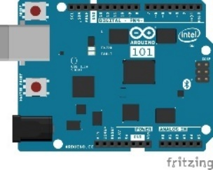
Lab Architecture
Development Workstation (Windows / OSx / Linux)
Resource Group <name>group
GET / POST
SEND / RECEIVE
SEND CLOUD-TO-DEVICE MESSAGES
App Service Plan <name>plan
Web App <name>web
IoT Hub <name>iot
Router w/ Internet Access
SQL Server
<name>sql
PowerBI Embedded Workspace Collection <name>collection
LOCAL RESOURCES
PowerBI Embedded Workspace
<name>workspace
AZURE RESOURCES
Report Temperature Chart
SQL Db
<name>db
INSERT
QUERY
RENDER
Stream Analytics
<name>job
SEND / RECEIVE
QUERY
Intel NUC / IoT Gateway
QUERY
Arduino 101 & Grove Base Shield
Buzzer
SEND
RECEIVE
Function App
<name>functions
Event Hub <name>alerts
Function TempAlert
Temperature Sensor
Rotary Angle Sensor
SEND CLOUD-TO-DEVICE-MESSAGES
2 Row LCD Display

Slide 4
Lab Architecture
Resource Group <name>group
Development Workstation (Windows / OSx / Linux)
GET / POST
SEND / RECEIVE
SEND CLOUD-TO-DEVICE MESSAGES
App Service Plan <name>plan
Web App <name>web
IoT Hub <name>iot
SQL Server
<name>sql
PowerBI Embedded Workspace Collection <name>collection
PowerBI Embedded Workspace
<name>workspace
Report TemperatureChart
Router w/ Internet Access
SQL Db
<name>db
LOCAL RESOURCES
AZURE RESOURCES
OUTPUT
QUERY
RENDER
Stream Analytics
<name>job
DIRECT QUERY
INPUT
SEND / RECEIVE
Intel NUC / IoT Gateway
Arduino 101 & Grove Base Shield
OUTPUT
Function App
<name>functions
Buzzer
Event Hub Namespace
<name>ns
Function TempAlert
Event Hub <name>alerts
Storage Account <name>storage
Temperature Sensor
RECEIVE
SEND CLOUD-TO-DEVICE-MESSAGES
READ / WRITE
Rotary Angle Sensor
2 Row LCD Display

Slide 6
IoT Logo

Slide 7
arduino

Slide 8
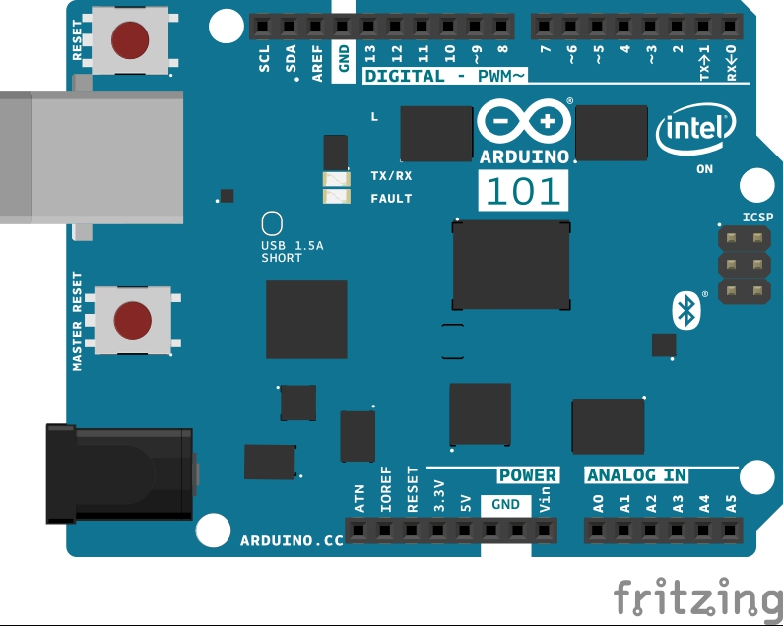
Arduino 101

Slide 9
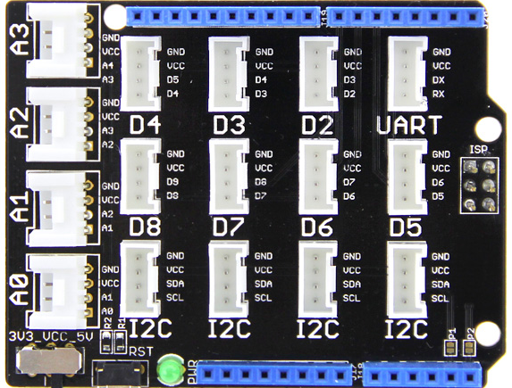
Grove Base Shield

Slide 10
Grove cable & SENSORS

Slide 11
Grove cable & SENSORS

Slide 12
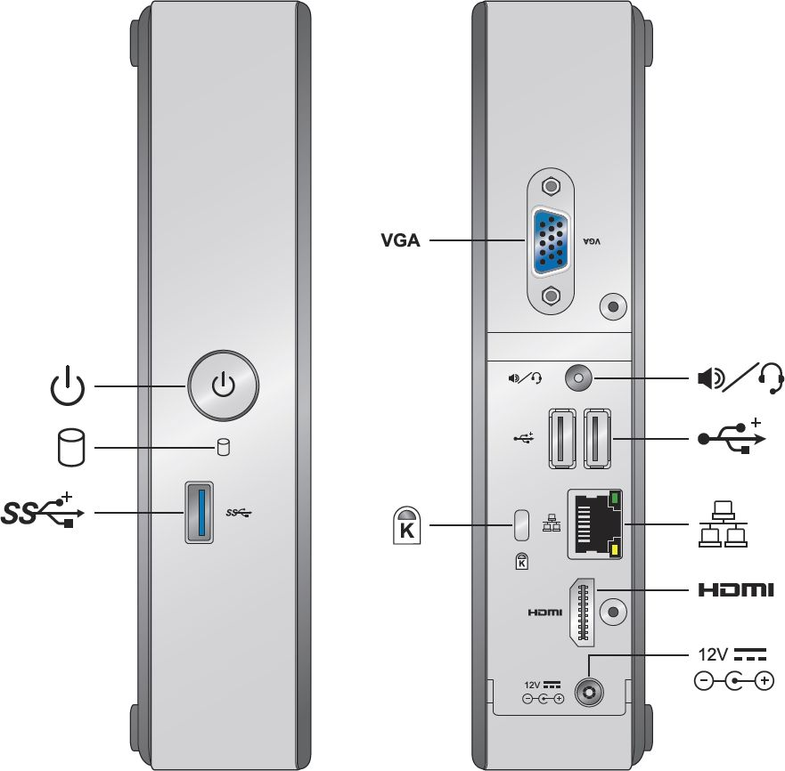
INTEL NUC DE3815TYKE

Slide 13
GALILEO BOARD

Slide 14
RASPBERRY PI

Slide 15
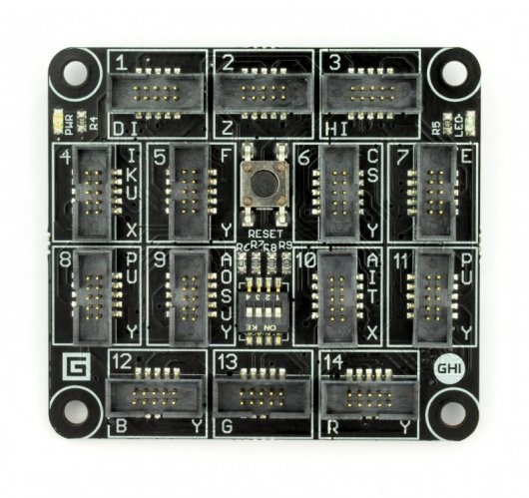
FEZ SPIDER MAIN BOARD

Slide 16
Sparkfun weather shield

Slide 17
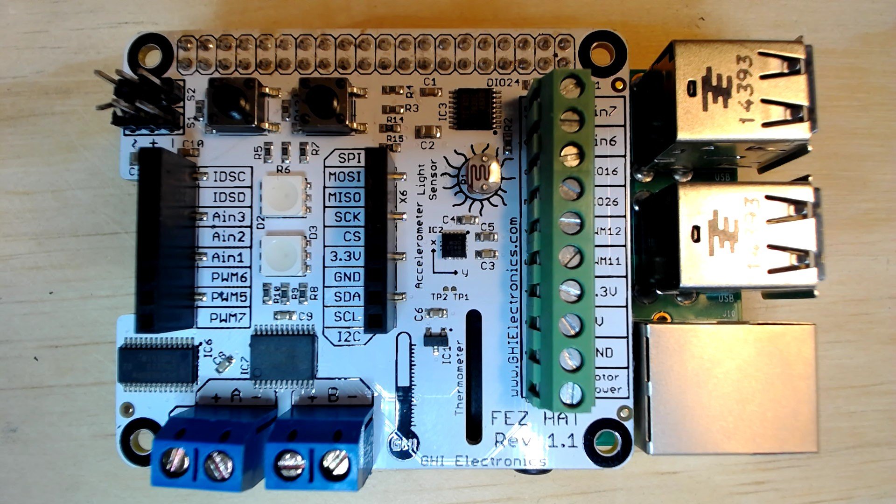
FEZ HAT

Slide 18
Connect the dots azure icons
Event Hubs
Stream Analytics
Storage
(
Azure
Microsoft Azure
Web App
Service Bus
)
Storage blob
Storage table
SQL database
HDInsight
Machine
(
Learning
GitHub code
Git repository
IoT Hubs
generic
)

Slide 19
LEDs

Slide 20
Resistors
220Ω
1st Digit
2nd Digit
Multiplier
Tolerance
Color | Name | 1st Digit | 2nd Digit | Multiplier | Tolerance
 | Black | 0 | 0 | X1
 | Brown | 1 | 1 | X10 | 1%
 | Red | 2 | 2 | X100
 | Orange | 3 | 3 | X1,000
 | Yellow | 4 | 4 | X10,000
 | Green | 5 | 5 | X100,000
 | Blue | 6 | 6 | X1,000,000
 | Violet | 7 | 7
 | Grey | 8 | 8
 | White | 9 | 9
 | Gold |  |  | X0.1 | 5%
 | Silver |  |  | X0.01 | 10%
330Ω
10KΩ

Slide 21
cables

Slide 22
More cables and adapters

Slide 23

LEDs
Anode (+)
Cathode (-)
Flat Edge
Small Post
Big Post
Long Leg
Short Leg
Vcc (+)
GND

Slide 24
LEDs

Slide 25
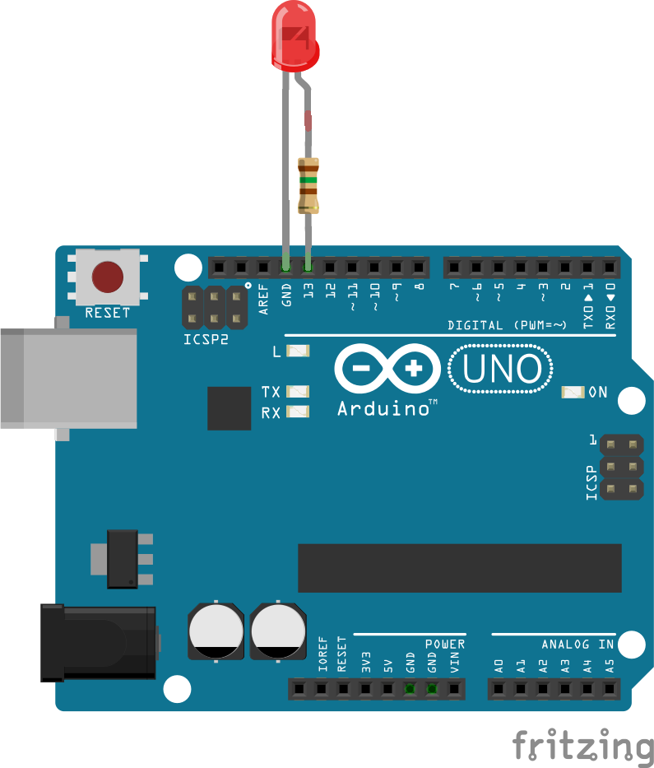

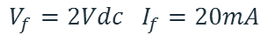
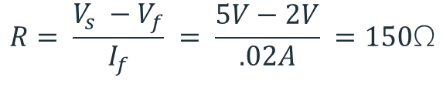
Current limiting resistors
Providing more current than an LED is rated for can destroy the LED. To prevent that, you should use a “Current Limiting” resistor.
To calculate the value of the resistor you need to know the supply voltage (Usually 5V on the Arduino Uno), and the LEDs rated Forward Voltage (the voltage drop across the LED) and Forward Current (the maximum current the LED can handle).
$$V_{f}=2Vdc I_{f}=20mA$$
$$Resistor Value (R)= \frac{Supply Voltage \left(V_{s}\right)−LED Forward Voltage (V_{f}) }{LED Forward Current (I_{f})}$$
$$V_{s}=5Vdc$$
$$R= \frac{V_{s} −V_{f}}{I_{f}} = \frac{5V−2V}{.02A} =150\text{Ω}$$
The Arduino Uno has a built in current limiting resistor on Pin 13. If you use Pin 13 to power your LED you can use it without a separate resistor.

Slide 26
Resistors
220Ω
1st Digit
2nd Digit
Multiplier
Tolerance
Color | Name | 1st Digit | 2nd Digit | Multiplier | Tolerance
 | Black | 0 | 0 | X1
 | Brown | 1 | 1 | X10 | 1%
 | Red | 2 | 2 | X100
 | Orange | 3 | 3 | X1,000
 | Yellow | 4 | 4 | X10,000
 | Green | 5 | 5 | X100,000
 | Blue | 6 | 6 | X1,000,000
 | Violet | 7 | 7
 | Grey | 8 | 8
 | White | 9 | 9
 | Gold |  |  | X0.1 | 5%
 | Silver |  |  | X0.01 | 10%
330Ω
10KΩ

Slide 27
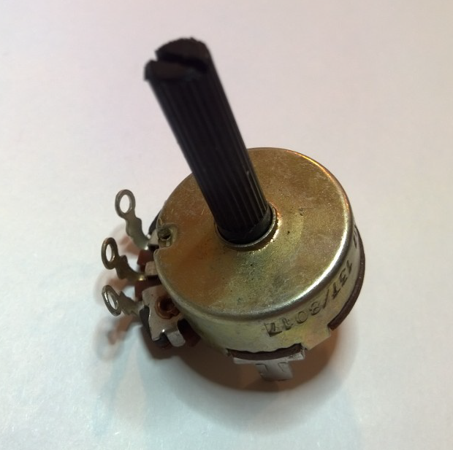
Potentiometer – variable resistor

Slide 28
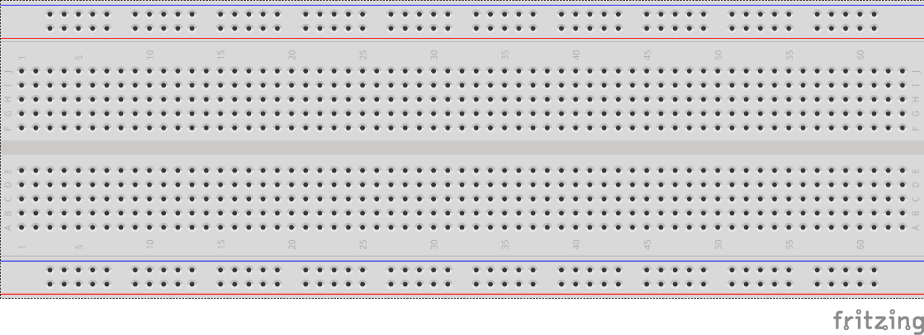
breadboards
Breadboards offer a great way to prototype circuits. The provide a number of “buses” for connecting both power and components.
Power buses run the entire horizontal length
Component buses give you easy ways to connect pins together

Slide 31
Micro SD Cards
Font: Segoe UI Semibold

